Slide 1
Superstore Sales dashboard

Slide 2
Introduction
This presentation introduces an advanced sales dashboard designed to provide deep insights into sales performance, profitability, and customer behavior.
The dashboard leverages data visualization and predictive analytics to support strategic decision-making.
We fetched the data in excel format and shaped the data using python's pandas.
Once the data is ready, we employed Plotly to visualize it.
We used the python dash library to craft a multi-page dashboard in Visual Studio Code.

Slide 3
Contents in dashboard
Sales Analysis (Sales by category and segment)
Profit Analysis (Profit by region and category)
Geographical Analysis
Forecasting (Forecasted sales and profits)
Total Metrics

Slide 4
Sales analysis by category and segment

Slide 5
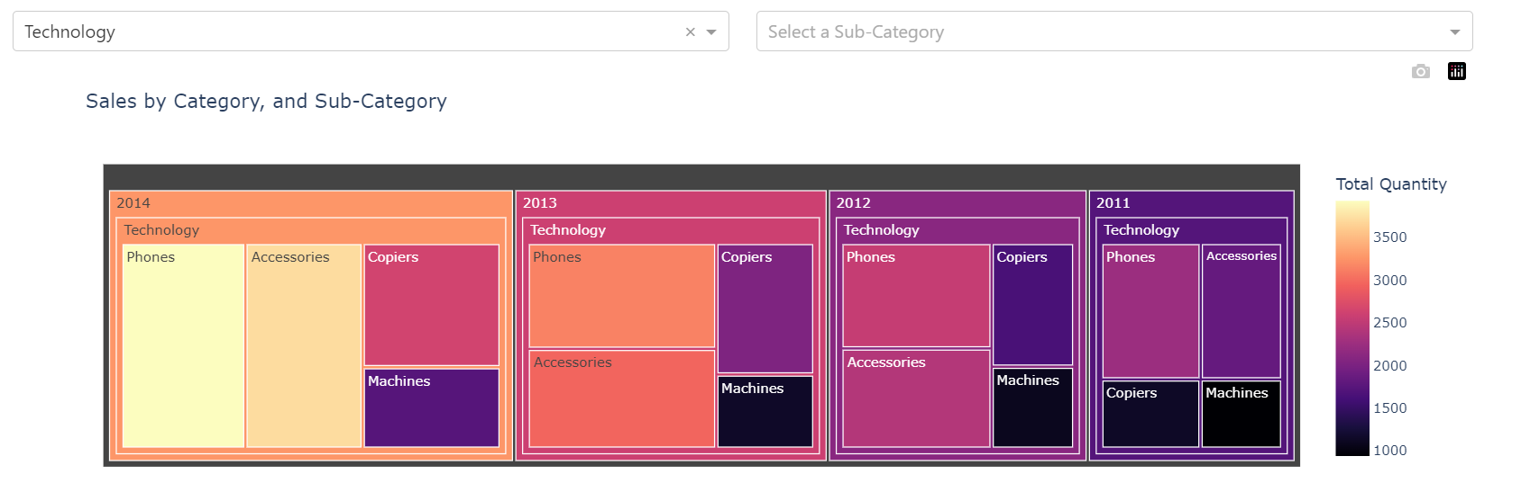
Sales by Category

Slide 6
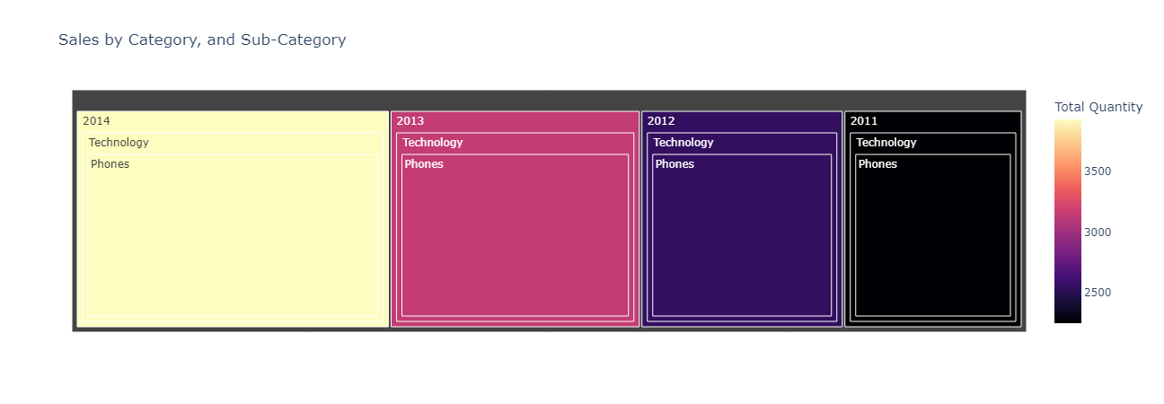
Sales by category

Slide 7
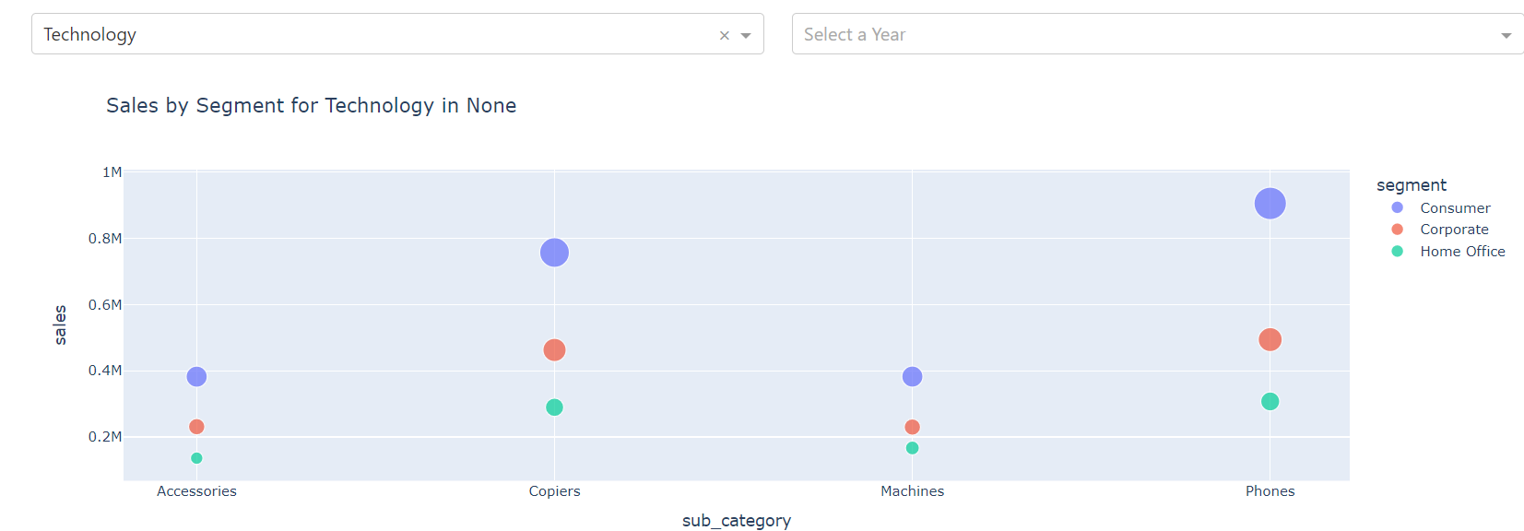
Sales by segment

Slide 8
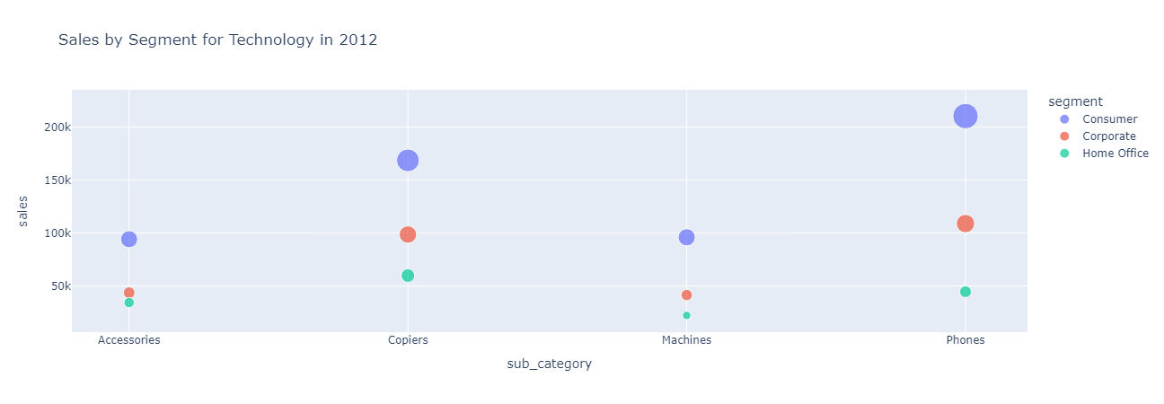
Sales by segment

Slide 9
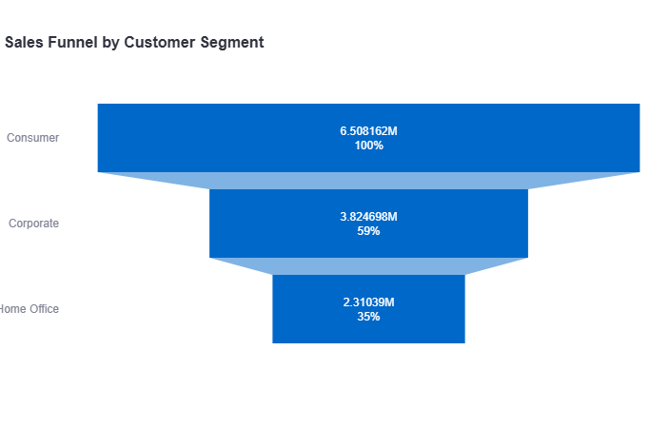
Sales by segment

Slide 10
Profit analysis and geographical analysis

Slide 11
Profit analysis
Financial performance
The total sales made is $12,643,249.91 and Total Profit made is $1,469,133.64
Trend analysis

Slide 12
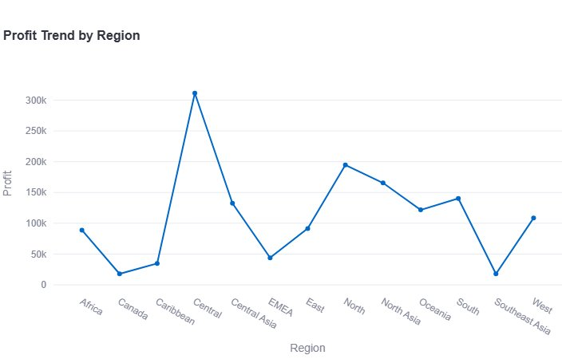
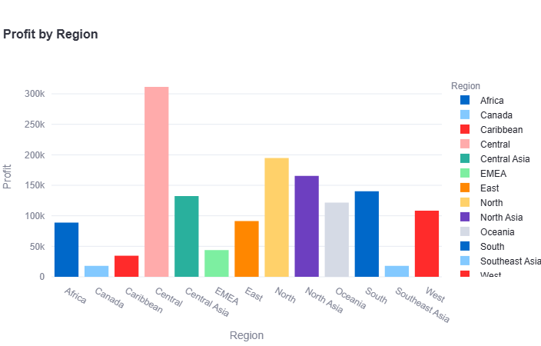
Top 5 regions with the highest profit.

Slide 13
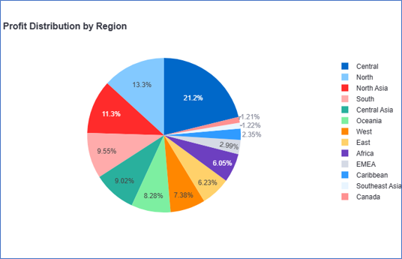
PROFIT DISTRIBUTION BY REGION

Slide 14
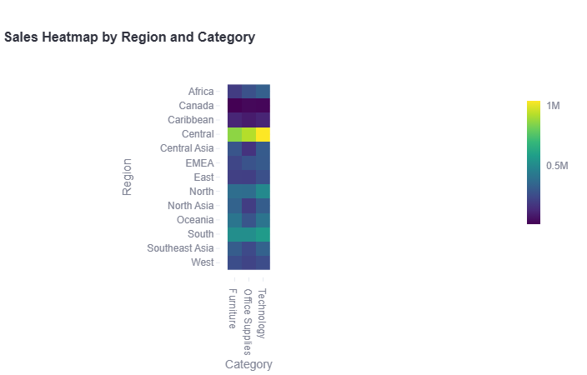
SALES HEATMAP

Slide 15
Impact of forecasted sales and forecasted profit on performance

Slide 16
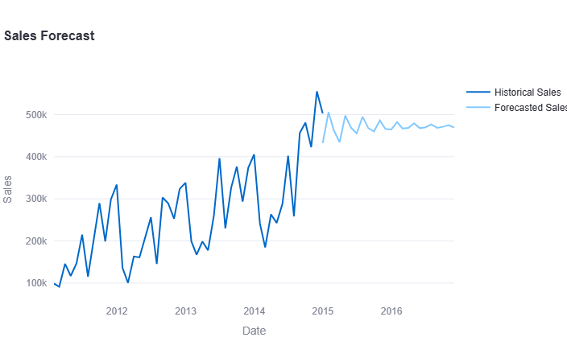
Utilizing Forecasted Sales for Strategic Store Management
Inventory management
Budgeting and Financial Planning
Staffing and Scheduling
Marketing and promotions
Supply Chain Management
Customer Relationship Management
Risk Management

Slide 17
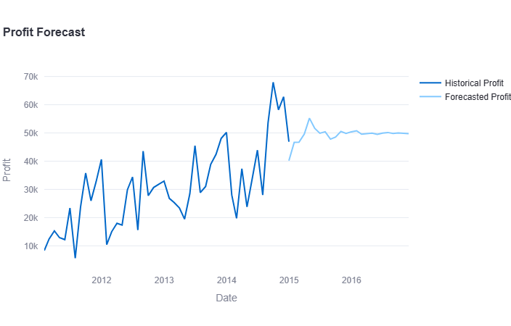
UTILIZING FORECASTED profits FOR STRATEGIC STORE MANAGEMENT
Inventory Management
Budgeting and Financial Planning
Pricing Strategies
Resource Allocation
Supplier Negotiations
Customer Relationship Management

Slide 18
Optimizing Store Performance with ARIMA
Accurate Forecasting: ARIMA models predict future sales and profits by identifying trends and seasonal patterns, aiding in inventory management and financial planning.
Inventory Management: With accurate sales forecasts, stores can optimize stock levels and demand planning, reducing overstock and stockouts while meeting customer demands.
Strategic Decision Making: Forecasting helps in planning effective marketing strategies, expansion, and investments by understanding sales trends and preparing for various scenarios.
Performance Monitoring and Risk Management: ARIMA models aid in setting realistic targets, monitoring performance, identifying anomalies, and running scenario analyses to mitigate risks.

Slide 19
Total Metrics

Slide 20
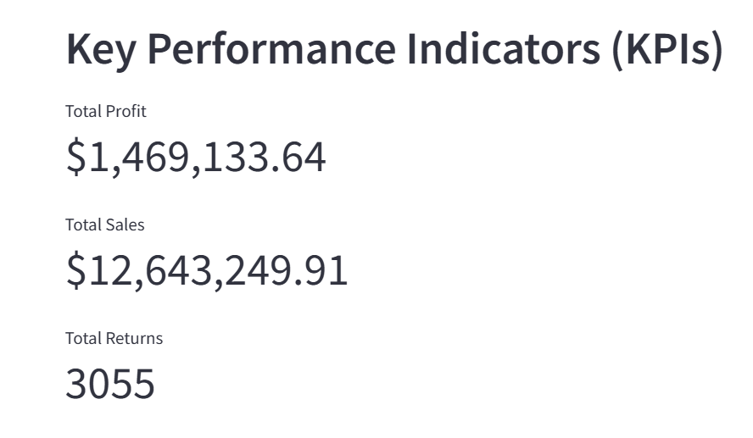
Total sales, profits & returns
Total Sales: Cumulative revenue from sales transactions.
Total Profits: Aggregate profit generated from sales transactions.
Total Returns: Count of returned items or orders.

Slide 21
Main features of dashboard
Comprehensive KPI Monitoring: The dashboard provides a clear snapshot of total profit, sales, and returns, offering a detailed view of the business's health.
Regional and Category Analysis: Identifies high-performing regions and categories, highlighting areas for targeted improvements and strategic focus.
Customer Segment Insights: Enables tailored marketing strategies, ensuring personalized and effective customer engagement.
Predictive Analytics for Future Planning: ARIMA models forecast future sales and profits, allowing proactive inventory management, budgeting, and strategic planning.
Granular Visualizations: Heatmap, Pareto analysis, and sales funnel provide deep insights for informed decision-making.

Slide 22
Additional features of dashboard
Excel File Upload: Easily upload your sales and returns data through a simple Excel file interface, enabling quick data integration and analysis.
Long-Term Forecasting: The dashboard utilizes ARIMA models to forecast sales and profits up to 2 years into the future, providing a strategic advantage in planning and resource allocation.
User-Friendly Interface: Navigate through a range of interactive charts and graphs to gain insights on key metrics such as profit by region, sales by category, and sales distribution by segment.
Export Options: Easily export data and visualizations for sharing with stakeholders and team members.

Slide 23
Thank you

